Slide 1
Introduction
Heat required for fusion of components being welded comes from different sources in different fusion welding processes (gas, arc and high energy beam).
Arc power (arc current I X arc voltage V),
Different welding processes provide heat at different power densities due to the fact that it is applied over different areas on the surface of base metal in case of different processes.
Power density (kW/mm2) is directly governed by:
area over which heat is applied (P/A)
welding parameters

Slide 2
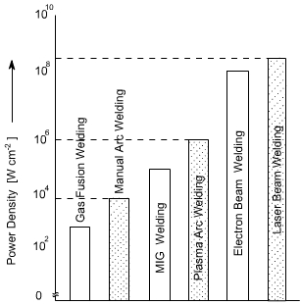
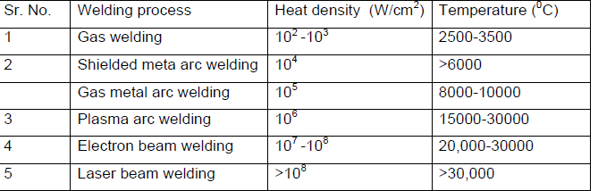
Introduction
Heat intensity and maximum temperature related with different welding processes

Slide 3
Effect of power density
Fusion welding processes are based on localized melting using high-density heat energy to ensure melting of base metal in short time
It is necessary that energy density of welding process is high enough
Heat required for melting the unit quantity of a given metal is constant andis a property of material.
Heat for melting comprises sensible heat and latent heat.
Latent heat for steel is 2 kJ/mm3.

Slide 4
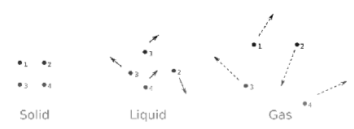
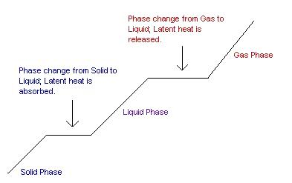
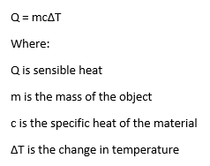
Heating Curve for a Pure Metal
Ql = M * Delta H
Delta H=H3-H2
2
3
Qs = M * C * Delta T
Delta T=T2-T1
1

Slide 5
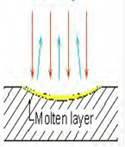
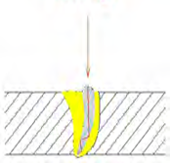
Effect of power density
Low power density heat source
High power density heat source

Slide 6
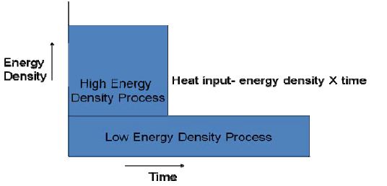
Effect of power density
heat input α (1 / Power density)
heat input α time (during welding)

Slide 7
Effect of power density
An increase in power density decreases the heat input required for melting because it decreases time over which heat is to be applied during welding for melting.
The decrease in heat application time lowers the amount of heat dissipated away from the faying surfaces to the base metal so the most of the heat applied on the faying surfaces is used for their fusion only
Time to melt the base metal is found inversely proportional to the power density of heat source

Slide 8
Effect of Power Density

Slide 9
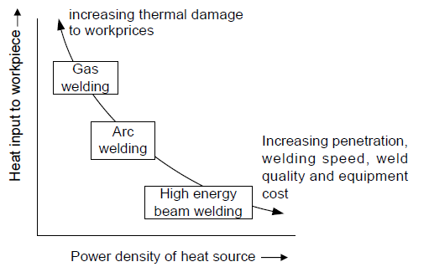
Effect of power density
Effect of power density of heat source on heat input required for welding

Slide 10
Need of optimum power density of welding process
Low power density processes need higher heat input than high power density processes.
Neither too low nor too high heat input is considered good for developing a sound weld joint.

Slide 11
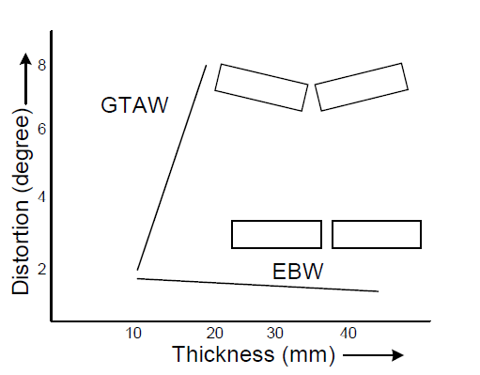
Need of optimum power density of welding process
-Low heat input can lead to:
lack of penetration and
poor fusion of faying surfaces
-Excessive heat input may cause:
damage to the base metal in terms of
distortion, softening of HAZ and
Reduced mechanical properties
Effect of welding process on angular distortion of weld joint as a function of plate thickness

Slide 12
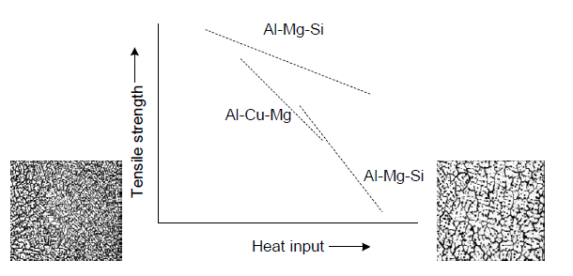
Need of optimum power density of welding process
High heat input lowers the tensile strength of many aluminum alloy due to:
thermal softening of HAZ and
development of undesirable
metallurgical properties of the
weldment
Use of high power density offers
many advantages such as:
deep penetration,
high welding speed and
improved quality of welding joints.
effect of heat input on tensile strength of
aluminum alloy weld joints

